Slide 1


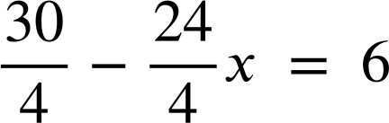
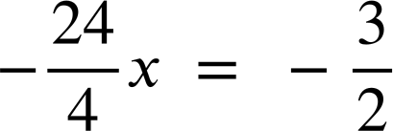
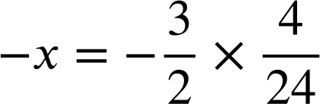
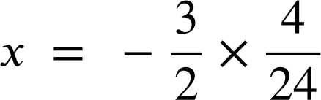
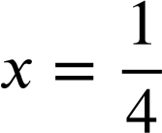
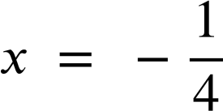
Checking and securing solving linear equations
Task A: Solving equations involving a bracketed expression
1) Spot the mistake in each method to solve an equation involving brackets.
a)
b)
c)
5(x + 10) | = | 55
5x + 10 | = | 55
5x | = | 45
x | = | 9
2(4x + 10) | = | 18
2x + 5 | = | 9
2x | = | 4
x | = | 2
7(x − 3) | = | 42
x − 3 | = | 6
x | = | 3
The brackets have not been expanded properly.
The second line should be 5x + 50 = 55
When dividing the LHS by 2 the terms in the bracket should not be divided.The second line should be 4x + 10 = 9
The additive inverse of −3 is + 3 so 3 should have been added to both sides. Line 3 should be x = 6 + 3 or x = 9
d)
e)
f)
(10 − 8x) | = | 6
5(3x + 2) | = | 14
8x + 10 | = | 14
8x | = | 4
x | = | 2
(2x − 5) | = | 15
2x − 5 | = | 3
2x | = | 8
x | = | 4
The brackets have not been expanded properly 5 and 3 should be multiplied not added. The second line should be 15x + 10 = 55
The reciprocal of a third is three.
The first step should be to multiply by 3 not divide by 3.
It would have been easier to multiply by the reciprocal first.

Slide 2
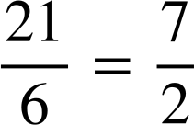
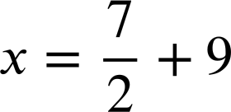
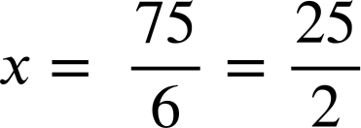
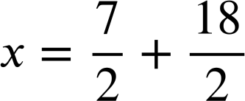
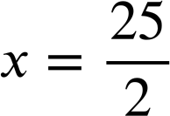
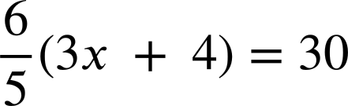

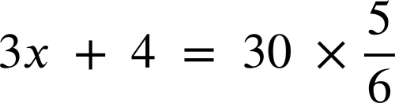







Checking and securing solving linear equations
2a) Solve this equation using both methods and write a sentence comparing the efficiency of the methods.
Expanding first:
Multiplying by the reciprocal first:
6(x − 9) | = | 21
6x − 54 | = | 21
6x | = | 75
6(x − 9) | = | 21
x − 9 | =
The second method requires a lot more fractions skills so the first method is likely to be more efficient.
2b) Solve this equation using both methods and write a sentence comparing the efficiency of the methods.
Expanding first:
Multiplying by the reciprocal first:
15(4x + 7) | = | 45
60x + 105 | = | 45
60x | = | −60
x | = | −1
This is personal preference. Both expressions have a common factor of 15 so dividing by 15 first makes the values smaller and potentially easier to work with compared to expanding the brackets first.
15(4x + 7) | = | 45
4x + 7 | = | 3
4x | = | −4
x | = | −1
2c) Solve this equation using both methods and write a sentence comparing the efficiency of the methods.
Expanding first:
Multiplying by the reciprocal first:
It is much easier to ‘undo’ the multiplicative step first this time as is an integer

Slide 3
Checking and securing solving linear equations
Task B: Solving equations with multiple brackets
1) The solutions to the equations are given. Fill in the steps to show how to get to these answers. Other methods may also be valid.
a)
b)
c)
5(x + 6) | = | 7(9x − 4)
5x + 30 | = | 63x − 28
30 | = | 58x − 28
58 | = | 58x
x | = | 1
2(4x − 5) | = | −6(3x − 7)
4x − 5 | = | −3(3x − 7)
4x − 5 | = | −9x + 21
13x | = | 26
x | = | 2
8(x − 5) + 3(x + 5) | = | 8
8x − 40 + 3x + 15 | = | 8
11x − 25 | = | 8
11x | = | 33
x | = | 3
d)
e)
f)
4(3x − 1) − 2(3x − 1) | = | 22
2(3x − 1) | = | 22
3x − 1 | = | 11
3x | = | 12
x | = | 4
2(4x − 9) − 4(3 − 2x) | = | 50
8x − 18 − 12 + 8x | = | 50
16x − 30 | = | 50
16x | = | 80
x | = | 5
3(2(x + 4)+5) | = | 75
3(2x + 8 + 5) | = | 75
3(2x + 13) | = | 75
2x + 13 | = | 25
2x | = | 12
x | = | 6
2) Solve these equations twice. Firstly by expanding first, secondly by simplifying before expanding. Write a sentence to compare the efficiency.
a)
4(x + 5) + 3(x + 5) | = | 14
4x + 20 + 3x + 15 | = | 14
7x + 35 | = | 14
7x | = | −21
x | = | −3
E.g. Both methods were reasonably efficient. Simplifying first meant that a common factor could be seen which eliminated a step.
4(x + 5) + 3(x + 5) | = | 14
7(x + 5) | = | 14
x + 5 | = | 2
x | = | −3
b)
21 + 3(2x − 3) | = | 7(2x − 3) − 3(2x − 3)
21 + 6x − 9 | = | 14x − 21 − 6x + 9
6x + 12 | = | 8x − 12
12 | = | 2x − 12
24 | = | 2x
x | = | 12
21 + 3(2x − 3) | = | 7(2x − 3) − 3(2x − 3)
21 + 3(2x − 3) | = | 4(2x − 3)
21 | = | 2x − 3
24 | = | 2x
x | = | 12
E.g. Simplifying first seemed to be more efficient. No expanding brackets was necessary and less manipulating negative numbers was needed.
Mathematics in Education and Industry
v2.3

